Slide 1

RGB addressable LED CONTOLLER
Present by:-
Mansi C. Satani
Roll no. :- 143
Exam No. :- 3271
Krishna R. Rudani
Roll no. :- 140
Exam no. :- 3268
Class :- TYBCA
Div :- C
Project guide :- Prof. Nehal Patel

Slide 2
About Led controller
The major advantage of a lighting control system over stand-alone lighting
controls or conventional manual switching is the ability to control individual lights or
groups of lights from a single user interface device. This ability to control multiple
light sources from a user device allows complex lighting scenes to be created. A
room may have multiple scenes pre-set, each one created for different activities in
the room. A major benefit of lighting control systems is reduced energy consumption.
Longer lamp life is also gained when dimming and switching off lights when not in
use. Wireless lighting control systems provide additional benefits including reduced
installation costs and increased flexibility over where switches and sensors may be
placed.

Slide 3
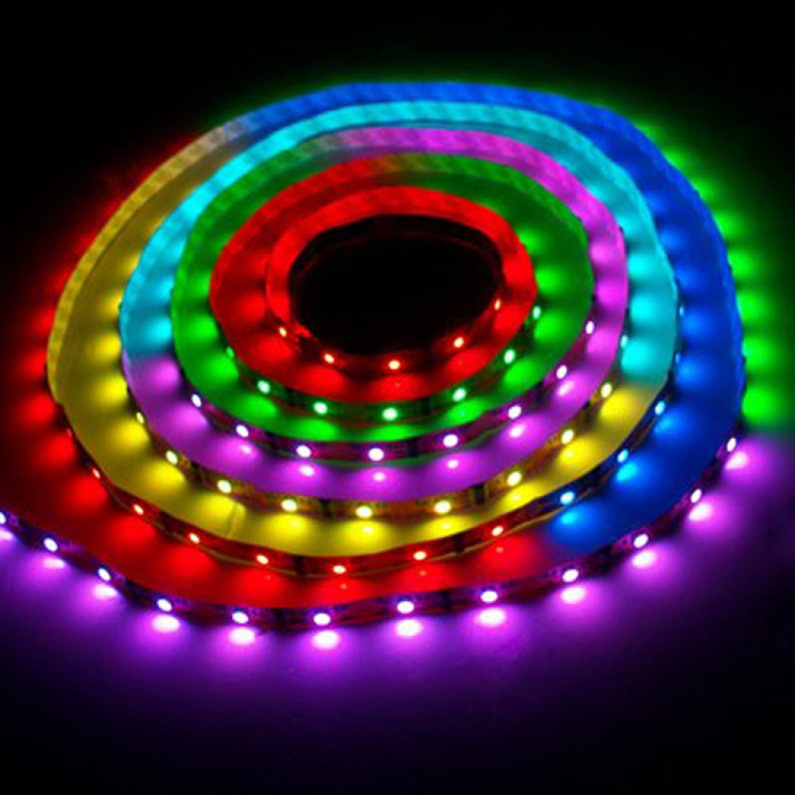
What is rgb LED controller?
The RGB LED controller tunes the strengths of three basic colours of red, green, and blue, and mixes them to generate any specific colour. Through wired or remote control, the RGB controllers can also manage the colour-changing modes, such as strobe, fading, and flash, as well as colour-changing order and speed.

Slide 4
Required components for LED controller

Slide 5
LED -frame
RGB addressable LED
Node-MCU
Dc power supply
USB cables

Slide 6
LED frame(MDF)
MDF (Frame) :-
MDF is traditionally made of wood fibers that have been broken down into residuals, then mixed with wax and resins and heat pressed into dense, durable sheets. A sheet of MDF will be heavy, smooth and even, with a flat surface that can be painted or sealed.
It’s prized for some surface uses because it’s uniform and smooth. While it typically contains urea-formaldehyde as part of its manufacturing process, it can also be specified as NAF or no added formaldehyde for those concerned about off-gassing

Slide 7
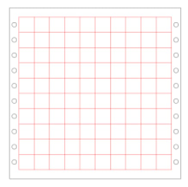
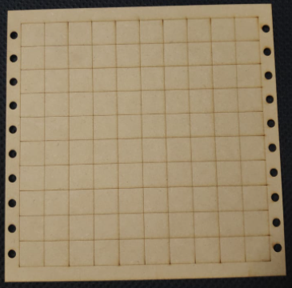
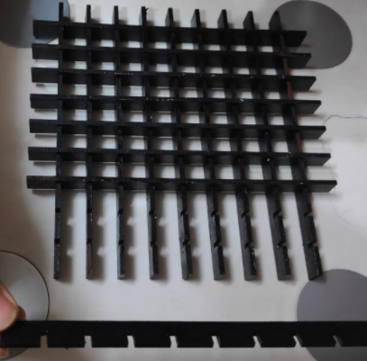
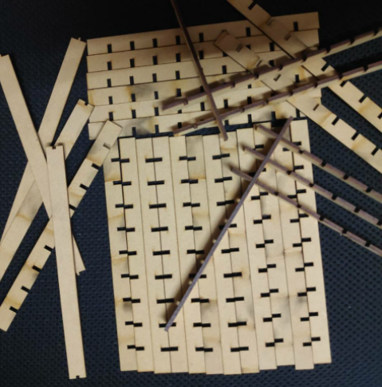
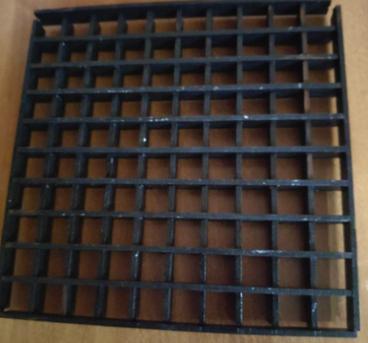
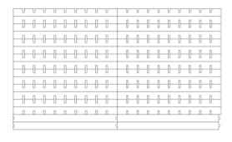

Slide 8
RGB addressable LED
Ws2812b(RGB LED strips) :-
Each separate red, green, and blue LED in a single WS2812B unit is set up to shine at 256 brightness levels, indicated by an 8-bit binary sequence set from 0 to 255.
A microcontroller transmits this sequence of eight green bits, eight red bits, and eight blue bits to the first LED in the series.

Slide 9
Why Addressable Led strip?
As a digital LED strip, each addressable LED has an integrated driver that allows the brightness and color of each LED to be controlled individually, that is, an LED can be a different color to the one next to it. Thus, it enables us to create beautiful and complex lighting effects.
Addressable LEDs are neither controlled by voltage, nor Pulse-Width Modulation. They are controlled by a carrier signal. This 800kHz signal has a format that describes to the chip what each of the colors should be, what the brightness should be, and also what every LED in the chain downstream should be too.

Slide 10
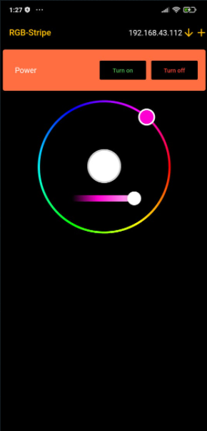
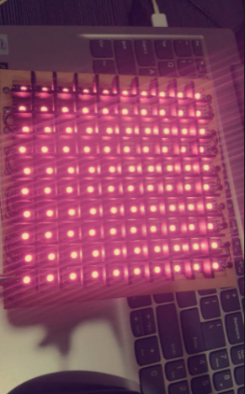

Slide 11
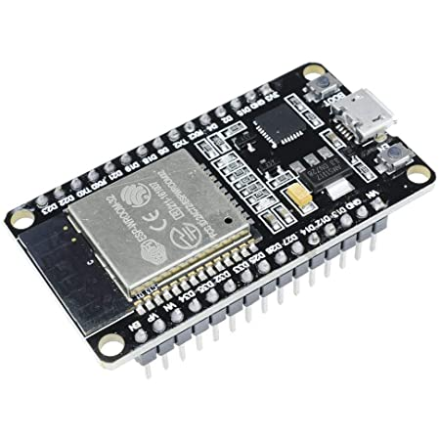
Node MCU
ESP32 (IoT Device)
ESP32 is a series of low-cost, low-power system on a chip microcontrollers with integrated Wi-Fi and dual-mode Bluetooth.
ESP32 is created and developed by Espressif Systems, a Shanghai-based Chinese company.

Slide 12
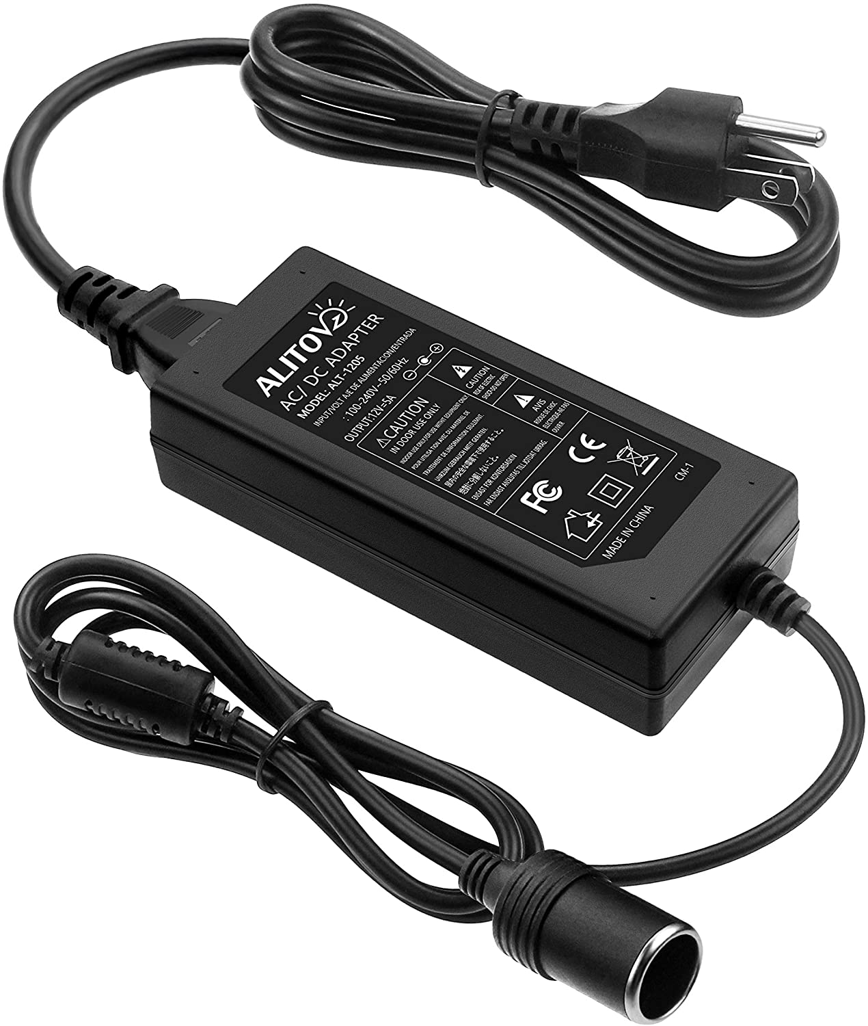
DC power supply
DC power supplies are power supplies which produce an output DC voltage. Power supplies are devices that deliver electric power to one or several loads. They generate the output power by converting an input signal into an output signal (in this case, a DC output).

Slide 13
USB Cables
Micro USB cable:-
Micro USB is a miniaturized version of the USB (Universal Serial Bus) interface developed for connecting compact and mobile devices such as your smartphones, MP3 players, GPS devices, photo printers, and digital cameras.
Type C USB cable:-
A USB-C cable is a preferred mode for charging and transferring data. Its connector has a unique shape. It can also support various USB versions like USB 3.1 and USB Power Delivery. This cable's symmetrical shape helps you to connect it to your device in any orientation.

Slide 14
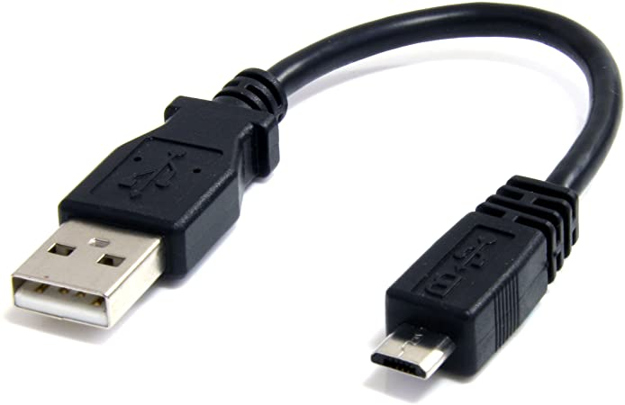
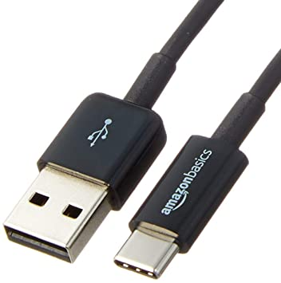
Micro USB cable
Type C USB cable

Slide 15
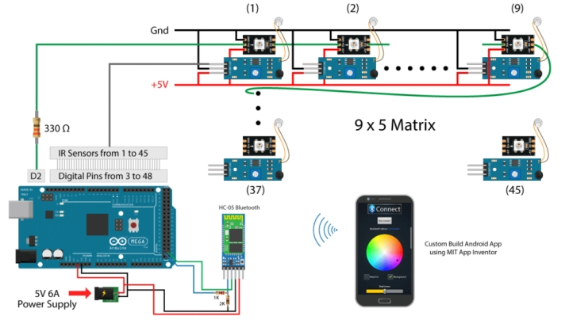
How led controller will work?

Slide 16
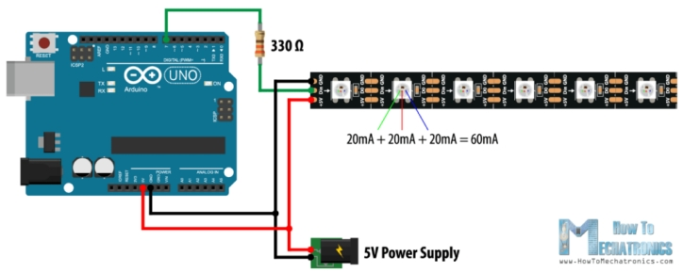
Connection of leds with nodemcu

Slide 17
Future Development
We further look forward to develop our application in various fields.
Similarly we are looking forward to add some beats of songs and pattern according to
that particular beat ,Then transforming the LED look by adding the frame over it and
make it more presentable.
Also we are planning to make it usable for the parties, home
decorations ,theaters and for many more places which can be turn boring to some
interesting interior by this LED patterns.

Slide 18
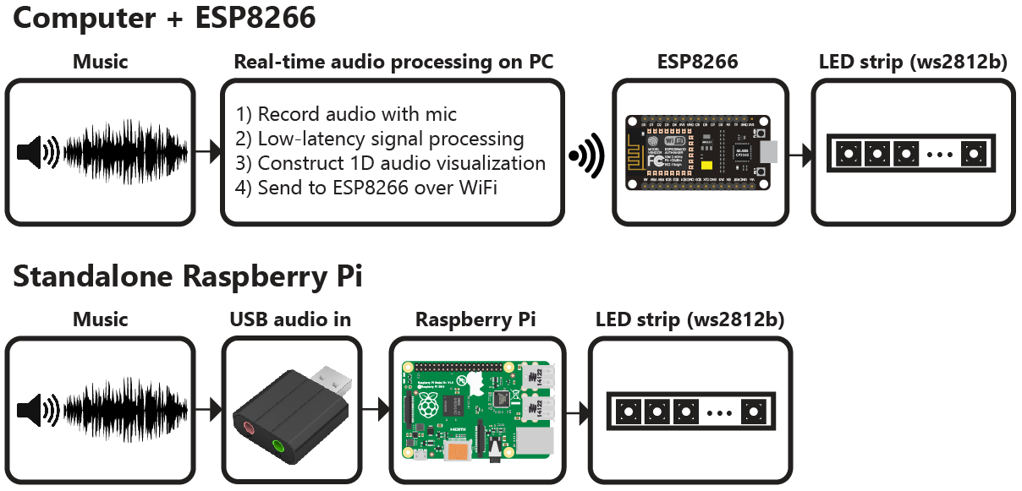
How Led with audio device will work?

Slide 19
References
individually-addressable-leds-using-arduino/
https://www.youtube.com/watch?v=UhYu0k2woRM
https://howtomechatronics.com/tutorials/arduino/how-to-control-ws2812b-
individually-addressable-leds-using-arduino/
http://arduino.esp8266.com/stable/package_esp8266com_index.json

Slide 20
Thank you

